Slide 1


Slide 2
Repetition Statements
Loops
Used to repeat a block of code multiple times until a specified condition is met (looping) or for iterating over a sequence of elements (iteration)

Slide 3
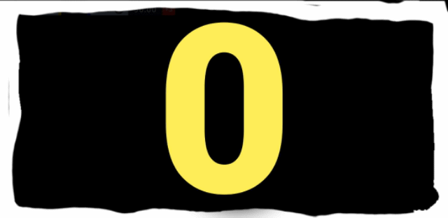

Types of Loops
For Loop
Iterates over a sequence (e.g., list, tuple, string) or a range of numbers
While Loop
Repeats a block of code as long as a specified condition is true

Slide 4
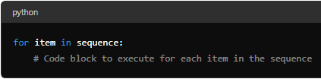
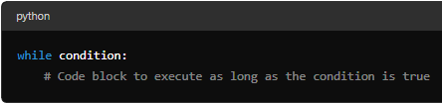
Syntax
FOR LOOP
WHILE LOOP

Slide 5
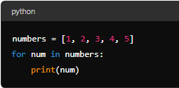
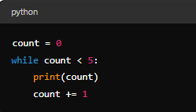
Examples
FOR LOOP
WHILE LOOP

Slide 6
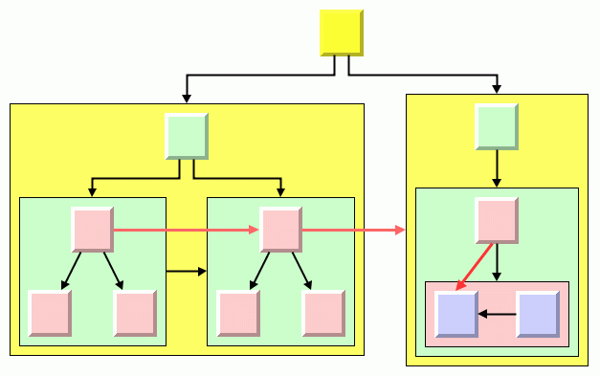
Nested statements
Statements that are placed within another statement

Slide 7

Think about 2 real life scenarios where nested structures are implemented

Slide 8
Control Structure nesting

Slide 9

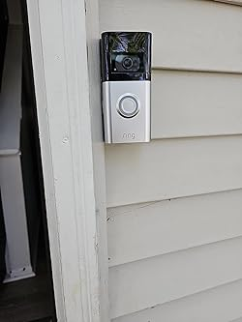

Slide 10
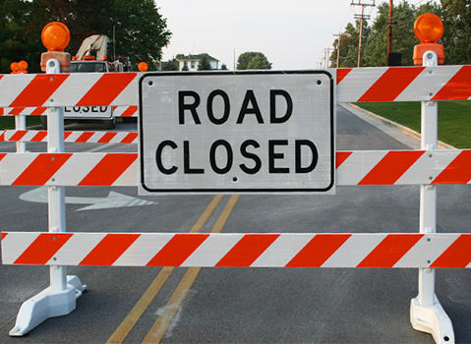

Slide 11



Slide 12
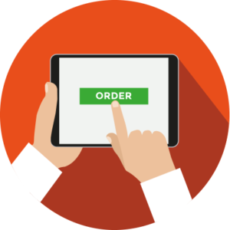


Slide 13



Slide 14
Think about 2 real life scenarios where control nesting is required

Slide 15
Repetition Structure nesting

Slide 16
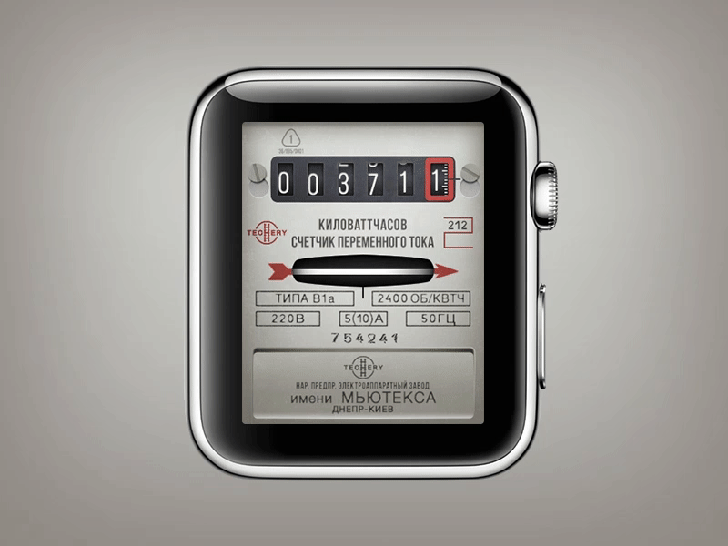

Slide 17
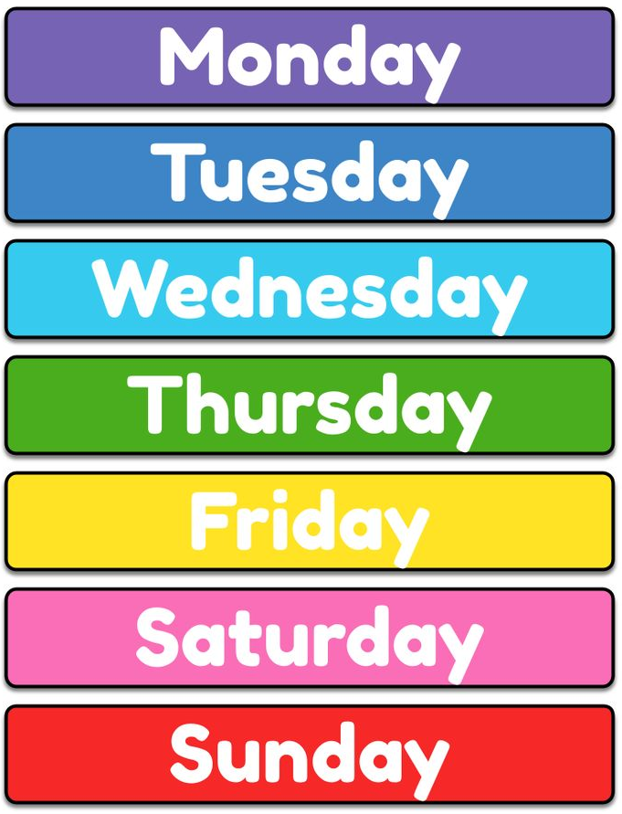






Slide 18
Read a number from user and print its table using for/while loops

